Slide 1
Rainfall Data Science Analysis Project
Atharva Vairagade
22070521015
Sec A

Slide 2
Introduction
This project analyzes rainfall dataacrossIndianstatesanddistricts to uncover
rainfall trends and predict rainfall levels.
The dataset includes rainfall metrics ('actual', 'rfs', 'normal') from 2009 onwards.
MultipleMLtechniqueswereapplied—Regression,Classification,Clustering,and
Deep Learning —to derive different insights.

Slide 3
Dataset Overview
• Total Records: 151,139
• Columns: 10 (including state, district, rainfall values) • Period: 2009 onwards
• Clean dataset (no missing values or duplicates)
• Features: Mix of numerical and categorical variables

Slide 4
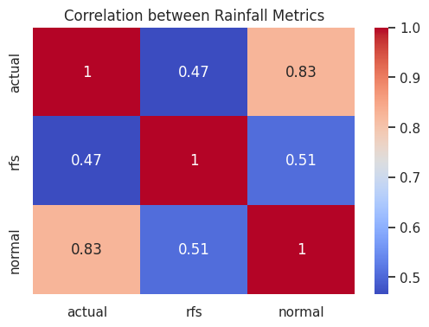
Data Cleaning & EDA
• Removed unnecessary ID columns and duplicates
• Encoded categorical columns (state_name)
• Verified dataset integrity (no nulls)
• Analyzed rainfall distributions and correlations
• Visuals: Rainfall distribution, state-wise rainfall trends

Slide 5
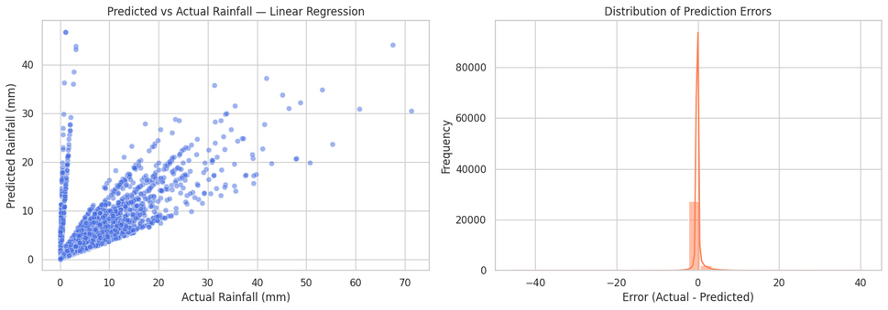
Regression Model
• Goal: Predict'actual'rainfallfrom'rfs','normal',andstateinfo
• Models: Linear, Polynomial Regression
• Evaluation: MAE, RMSE, R²
• Polynomial captured nonlinear rainfall patterns better • Visuals: Actual vs Predicted rainfall trend

Slide 6
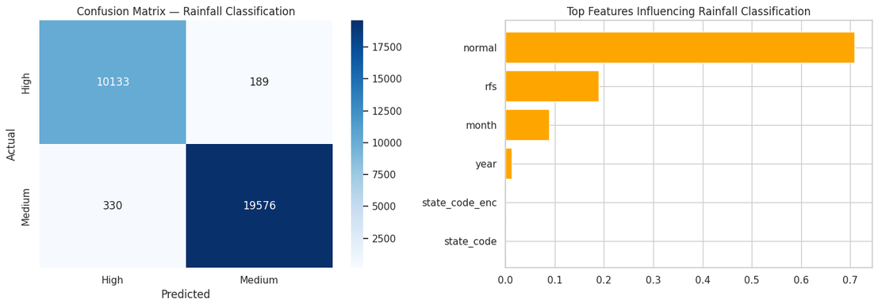
Classification Model
• Converted rainfall levels into categories(Low,Moderate,High)
• Applied Logistic Regression and Decision Tree • Metrics: Accuracy, Confusion Matrix
• Insights: Useful for rainfall alert system design • Visuals: Confusion matrix, Decision regions

Slide 7
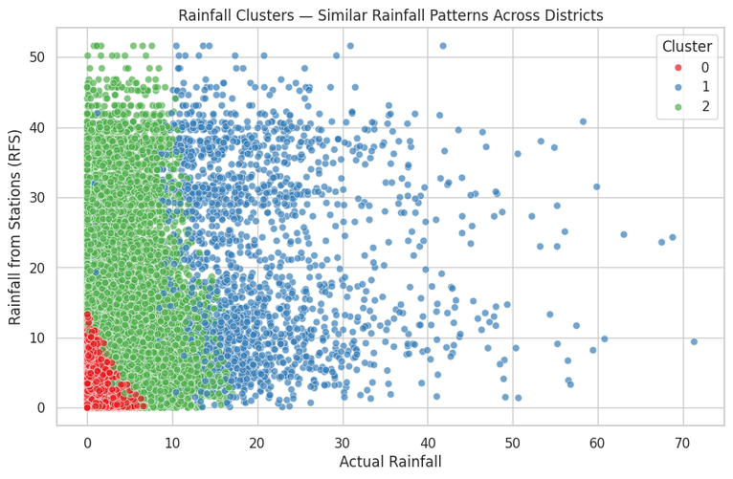
Clustering Model
• Used K-Meansclustering on rainfallmetrics
• Objective:Identify rainfall pattern regions
• Insights: Drought-prone vs. heavy rainfall districts
• Visuals:Clustered rainfall regions, Elbowplot

Slide 8
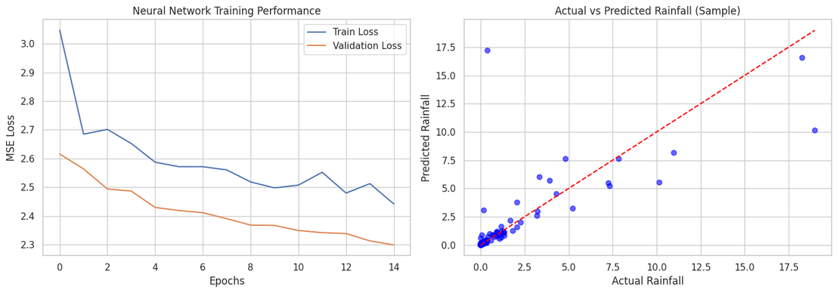
Deep Learning Model
• Neural Networkbuiltusing TensorFlow/Keras
• Inputs: Encoded rainfall and location features • Output: Predicted rainfall (continuous)
• R² ≈ 0.75 —performed best among all models • Visuals: Error distribution, Feature influence

Slide 9
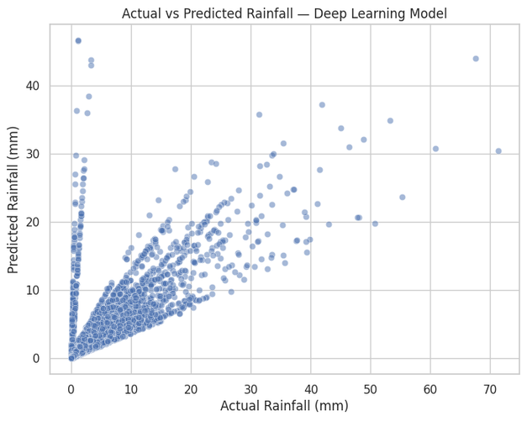
Visual Insights
• Scatter: Actual vs Predictedrainfall
• Trend: Year-wise rainfall variation
• Error Plot: Model deviation
• Feature Importance: Key rainfall predictors
• Simple visuals make results clear for all audiences

Slide 10
Conclusion
✅Regression & Deep Learningperformedbest
✅Clustering identified natural rainfall groups ✅Classification supports rainfall alert systems
🌱Future Scope:
• Integrate real-time weather data
• Apply deep temporal models (LSTM, CNN)
• Include satellite rainfall imagery for precision forecasting

